Slide 1


TECHNICAL SEMINAR
“Deep Learning for Computer Vision ”
Presented by:
Jyoti Singh
SAP ID-500106507
Roll No- R271222006
Master in Computer Application(Batch-B1)
School of Computer Science

Slide 2
Introduction of deep learning in computer vision-
Deep learning has revolutionized computer vision by enabling automatic feature extraction and pattern recognition.
Computer vision enables machines to analyze and understand visual information.
Neural networks have achieved state-of-the-art performance in tasks like image classification and object detection.
Motivation for the title selection-
This presentation explores how deep learning empowers neural networks to tackle complex computer vision challenges.

Slide 3
What is Computer Vision-
Enables machines to interpret and analyze visual data, mimicking human visual perception.
Key computer vision tasks include image classification, object detection, and image segmentation.
Image classification: Assigning labels or categories to images.
Object detection: Identifying and localizing specific objects within images.
Image segmentation: Dividing images into meaningful regions.
Applications in various fields such as autonomous vehicles and medical imaging.

Slide 4
IMAGE RECOGNITION

Slide 5
Introduction to Deep Learning-
Deep learning: Subset of machine learning using neural networks for predictions.
Neural networks: Interconnected layers of artificial neurons, inspired by the human brain.
Convolutional Neural Networks (CNNs): Designed for computer vision tasks.
CNNs: Extract features from images using convolutional layers and pooling.
Deep learning revolutionized computer vision: Achieved state-of-the-art performance.

Slide 6
Convolutional Neural Networks (CNNs)-
CNNs: Specialized deep learning architecture for computer vision.
Convolutional layers in CNNs apply filters to input images, extracting meaningful features.
Pooling layers downsample feature maps, reducing spatial dimensions and extracting dominant features.
Fully connected layers in CNNs make predictions based on the extracted features.
Training CNNs involves adjusting their parameters to minimize prediction errors.
Backpropagation is used to propagate errors backward through the network, adjusting weights and biases

Slide 7
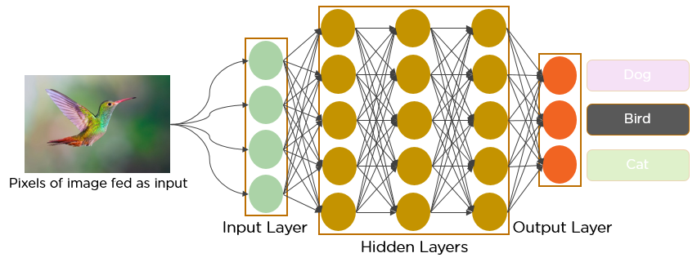
Convolutional Neural Networks (CNNs)-

Slide 8
Advanced Techniques in Computer Vision with Deep Learning-
Object detection: Locating and classifying multiple objects within an image.
Semantic segmentation: Assigning semantic labels to each pixel in an image.
Image generation: Creating new images based on learned patterns.
YOLO (You Only Look Once): A popular real-time object detection algorithm.
Mask R-CNN: Combines object detection with instance segmentation.
Generative Adversarial Networks (GANs): Used for realistic image generation.

Slide 9
Recent News and Innovations-
Self-supervised learning: Training models without explicit annotations, utilizing unlabeled data.
Transfer learning: Leveraging pre-trained models for improved performance on new tasks.
Real-time object detection: EfficientDet and EfficientPose, have enabled accurate and fast detection of objects in real-world scenarios.
Industry adoption and deployment
Enhancing productivity
Efficiency in tasks like quality control,anomaly detection,
and automated monitoring.

Slide 10
Conclusion-
Deep learning revolutionized computer vision, advancing image classification, object detection, and segmentation.
Ongoing advancements in self-supervised learning, attention mechanisms, and transfer learning enhance computer vision.
Integration with AR and VR creates immersive and interactive experiences.
Future holds transformative applications in diverse fields through improved efficiency and decision-making.
THANK YOU

